Slide 1


Java SE
(ADVANCE JAVA)
Lecture-11

Slide 2
Today’s Agenda
Constraining in ResultSet .
Creating scrollable and updateable ResultSet .
ResultSet concurrency.
Insert update delete in Resultset

Slide 3
CONSTRAINIG THE RESULTSET
Applying constraints to ResultSet means we want to set certain criteria on the record being returned from the table.
Restricting records obtained by the database in java.
To do this java provides us various methods available in Statement interface

Slide 4
RESTRICTING NO OF ROWS
public int getMaxRows() : returns current setting of max no. of rows
public void setMaxRows(int) : sets the max no. of rows which can be returned from the ResultSet.

Slide 5
SAMPLE CODE
int rows=stmt.getMaxRows(); // obtaining current setting
System.Out.println(“max rows returned will b:”+row);
stmt.setMaxRows(7); // restricting the resultset to 7 rows

Slide 6
QUESTION
WAP to display top two highest paid books from the
books table

Slide 7
RESTRICTING QUERY TIME
public int getQueryTimeout() : returns the current query time out setting in no. of seconds.
public void setQueryTimeout(int) : sets the specific time limit in seconds

Slide 8
Conti.
try
{
Statement st=conn.createStatement();
int maxtime=st.getQueryTimeout();
System.out.println(“current timeout setting:”+maxtime);
st.setQueryTimeout(10);
System.out.println(“now time out has became:”+st.getQueryTimeout());
}
catch(sqlException sql)
{
System.out.println(“Exception:”+sql);
}

Slide 9
UPDATABLE AND SCROLLABLEE RESULTSET
By default the Resultset which we create in java are ResultSet’s which can only move in forward direction
And they also don’t allow any kind of changes made into them.
In order to change this behaviour we need to handle its TYPE & CONCURRENCY.

Slide 10
SETTING SCROLLABILITY AND CONCURRENCY
To set scrollability and concurrency of the ResultSet we need to call the method createStatement( ) of the Connection object which has the following prototype:
public Statement createStatement(int scrollability,int
updatability) throws SQLException

Slide 11
RESULTSET SCROLLABILITY
ResultSet.TYPE_FORWARD_ONLY:
The cursor can only move forward in the result set.
i.e from before 1st row upto the last row and it is also
the default type of ResultSet.
ResultSet.TYPE_SCROLL_INSENSITIVE:
The cursor can scroll forward and backward, and the ResultSet is not sensitive to changes made by others to

Slide 12
Conti.
the database that occur after the result set was created.it can also move to an absolute position.
ResultSet.TYPE_SCROLL_SENSITIVE:
The cursor can scroll forward and backward, as well as to a absolute position and the result set is sensitive to changes made by others to the database that occur after the result set was created.

Slide 13
RESULTSET CONCURRENCY
The possible RSConcurrency are given below. If you do not specify any Concurrency type, you will automatically get one that is CONCUR_READ_ONLY.
ResultSet.CONCUR_READ_ONLY :
Creates a read-only result set. This is the default
ResultSet.CONCUR_UPDATABLE :
Creates an updateable result set.

Slide 14
Conti.
All our examples written so far can be written as
follows, which initializes a Statement object to create
a forward-only, read only ResultSet object
Statement stmt;
stmt=conn.createStatement(ResultSet.TYPE_FORWARD_ON
LY, ResultSet.CONCUR_READ_ONLY);

Slide 15
UPDATING THE RESULTSET
It is a two step process
We have to call the required updateXXX() method
- these methods are used for changing the values in
the column
prototype
public void updateXXX(int,XXX) throws
SQLException
int→ column position in ResultSet.
xxx→ new value we want to provide.

Slide 16
Conti.
For ex:
- the updateInt( ) method has:
public void updateInt(int,int)throws SQLExeption
- the updateString( ) method has:
public void updateString (int,string)throws
SQLExeption
These update method also have an overloaded version where 1st argument is string specifying column name-

Slide 17
Conti.
public void updateInt (String , int)
public void updateString (String , String)
After updation has been done we have to call the updateRow( ) method which finally transfers the changes to the database.
The prototype of the method is:
public void updateRow() throws SQLException

Slide 18
SAMPLE CODE
Statement st=conn.createStatement(ResultSet.TYPE_SCROLL_INSENSITIVE,ResultSet.CONCUR_UPDATABLE);
ResultSet rs=st.executeQuery("Select bookname,bookprice from allbooks ");
while(rs.next())
{
double amt=rs.getDouble(2);
rs.updateInt(2,amt+amt*.01);
rs.updateRow();
System.out.println(rs.getString(1)+”\t”+rs.getDouble(2));
}

Slide 19
INSERTING THE RESULTSET
Insertion of a row require four steps:
We have to call a method called moveToInsertRow() of result set , it moves the cursor to a special position called “insert row position”.
Add values to a specific column by calling updateXXX() method.
Call the method insertRow() of resultset ,so that the changes made are transferred to underlying database.
Call moveToCurrentRow() of resultset , so that the cursor moves back to the position where it was before calling moveToInsertRow().

Slide 20
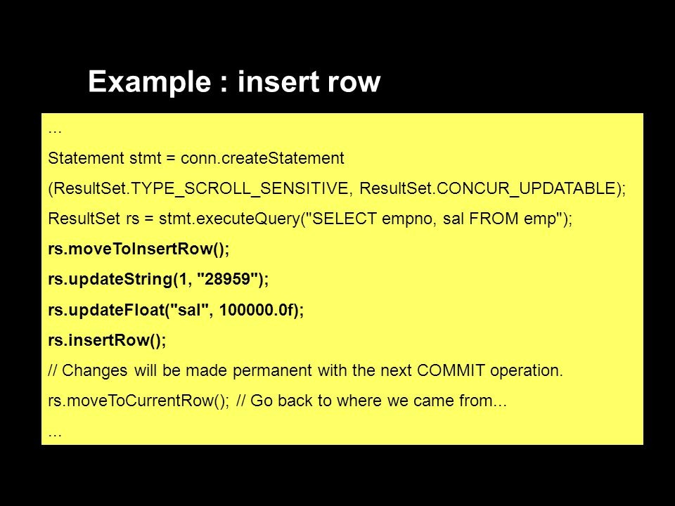
EXAMPLE

Slide 21
DELETE ROW
T0 delete any row from ‘resultset’ we just have to move the cursor to the desired position and then , we can call the method deleteRow() of resultSet.
Example :
rs.absolute(5);
rs.deleteRow();

Slide 22
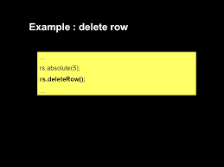
EXAMPLE

Slide 23

End Of Lecture
For any queries mail us @: scalive4u@gmail.com
Call us @ : 0755-4271659, 7879165533
Agenda for Next Lecture:
Concept Of Batch Update
How JDBC supports Batch Update

